Slide 1
Central Liquidity Facility (CLF)
Anthony Cappetta, President, CLF
June 2023
Any opinions expressed are the views of the presenters and do not necessarily reflect those of the National Credit Union Administration or the NCUA Board.

Slide 2
Credit Unions and Liquidity
On Balance Sheet
Market Funding
Backup Facilities
LTCU 13-CU-10 and 12 CFR 741.12, Liquidity and Contingency Funding Plans
1
2
3
Hold cushion of unencumbered high quality liquid assets
(e.g., cash, Treasuries)
Establish funding strategy that provides for diversified sources of funding (e.g., corporate credit union or bank LOC, FHLB advances, etc.)
Maintain access to a Federal contingent liquidity source for unexpected emergencies (i.e., Fed Discount Window or CLF)

Slide 3
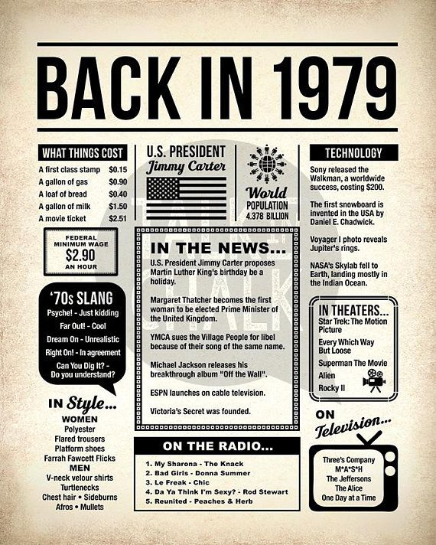
CLF
1978 NCUA CLF Act
Operational in 1979
Owned by members, managed by NCUA Board
Financially self supported
Access to federal source (U.S. Treasury)

Slide 4
CLF
CLF is a backup source of liquidity
CLF does not substitute for primary liquidity sources, it backs them
Essential during times of unusual/protracted liquidity disruptions
In times of crisis, access to a federal contingent liquidity provider is the most reliable source
CLF is a form of liquidity insurance
Access requires membership and membership boosts capacity
CLF-provided liquidity was instrumental in helping NCUA and the credit union system overcome the 2007/2008 financial crisis

Slide 5
Membership
Membership is Voluntary
Regular member
Natural person credit unions
Subscribe to CLF capital stock
Direct membership
Agent member
Corporate credit unions
Join on behalf of group of natural person credit unions
Agents act as conduit between CLF and their member credit unions

Slide 6
Membership
Benefits
More liquidity is better (in crisis)
Federal source makes access a “reliable thing”
Member capital translates to significant borrowing capacity for the CLF and its members
CLF can lend to the National Credit Union Share Insurance Fund (NCUSIF)
Helps individual credit unions and overall credit union system

Slide 7
Capital Stock
Established in Federal Credit Union Act (12 USC 1795c) and NCUA regulation (12 CFR § 725.2)
Amount based on a percentage of credit union’s paid-in and unimpaired capital and surplus
Subscribed capital stock: One half of one percent of a credit union’s unimpaired capital and surplus
(i.e., it’s shares and undivided earnings)
1/2 the stock requirement is “paid-in” and 1/2 is “on call” (maintained on credit union books in liquid assets)

Slide 8
Paid-in Capital Stock
Members receive a quarterly dividend on the paid-in portion of their capital stock
The dividend rate administered as an ability-to-pay commitment
The CLF pays dividends after covering expenses and meeting any retained earnings objectives
The CLF has always paid a dividend

Slide 9
CLF Borrowing Capacity
The CLF may borrow from any source with the limitation that the face value of its obligations do not exceed twelve times the subscribed capital stock and surplus of the CLF
For every dollar of capital and surplus, the CLF can borrow $12
The greater the number of members, the larger the capital borrowing base, the larger the borrowing capacity
Current borrowing capacity is $19.8 billion
Federal Financing Bank is an established advance provider

Slide 10
Accessing CLF
Access requires membership
Corporates Credit Unions are CLF Correspondents (Fiduciaries)
Accessing the CLF does not mean the NPCU is in trouble
Advances are underwritten for creditworthiness & “liquidity need” and secured with first priority security interest in collateral
NCUA Regional Directors, and SSAs in the case of state-chartered CUs, also provide input to ensure that the liquidity need is consistent with CLF's intended purpose and that the underlying reasons for the liquidity need do not constitute grounds for a material safety and soundness concern.
In the case of a non-federally insured credit union, the CLF will confer with the private insurer

Slide 11
Liquidity Need and Creditworthiness
The CLF evaluates liquidity needs and creditworthiness using a variety of information, as detailed in NCUA regulations § 725.18, which may include (but is not limited to):
Stated purpose of the loan;
Borrower’s plan and ability to repay the loan;
Statutory limitations on borrowing;
Borrower’s current financial condition, information from sources like Call Reports and Financial Performance Reports; some important metrics include:
Earnings
Net Worth/Total Assets
GAAP Tangible Equity
Stressed Tangible Equity
Loan to Share Ratio
Cash and Short-Term Instruments Ratio
Liquidity Coverage Ratio
Delinquencies

Slide 12
Creditworthiness
Certain unsatisfactory practices and/or conditions may cause the CLF to determine that a member is not creditworthy and is therefore ineligible to receive an advance. NCUA regulations § 725 lists the characteristics the CLF may consider as un-creditworthy
Insolvency as defined by § 700.1(k) ;
Unsatisfactory practices in extending credit;
Lower than desirable reserve levels;
High expense ratio;
Excessive dependence on borrowed funds;
Inadequate cash management policies and planning;
Other relevant characteristics indicating a less than satisfactory financial condition.
A credit union that fails to meet CLF creditworthiness standards may qualify for assistance from the National Credit Union Share Insurance Fund, as provided under § 208 of the Federal Credit Union Act.

Slide 13
Loans
Short-term adjustment credits
short-term adjustment credit are available to assist in meeting temporary requirements for funds, or to cushion more persist­ent outflows of funds pending an orderly adjustment of credit union assets and liabilities; Usually 90 days (can be up to one year)
Seasonal credits
seasonal credit are available for longer periods to assist in meeting seasonal needs for funds arising from a combination of expected patterns of movement in share and deposit accounts and loans, generally available for periods of up to 270 days;
Protracted adjustment credits
protracted adjustment credit are available in the event of unusual or emergency circumstances of a longer-term nature resulting from national, regional or local difficulties that are advances with varying terms.
12 U.S. Code § 1795a

Slide 14
Collateral
Prepositioning of collateral is not required, but the CU should ensure assets are available and unencumbered
The CLF takes a 1st priority security interest in assets pledged
Assets must have a readily determinable market price or other reasonable estimate of value
If the CU has multiple sources of liquidity from different lenders, it may require coordination between those 3rd parties
Corporate Correspondents help service and administer liquidity advances
Correspondents manage collateral and perfect first lien security interests
Pledged assets must have a value at least equal to the CLF collateral margins table OR a NCUSIF guarantee
Collateral and haircut methodologies are similar to the Federal Reserve Discount Window

Slide 15
Rates
All advances by the CLF to Regular members reflect a loan rate based on the Facility’s costs
The advance rate is the greater of the Fed’s Primary Credit Rate (currently 5.25%) or the Federal Financing Bank (FFB) advance rate (Treasury Bill yield plus 1/8th of a point)
Advance rates from the FFB are based on the current average market yield on bills with the remaining time to maturity of the advance
Due to the variability of the borrowing timeline, the CLF can not provide the borrowing rate in advance of the loan request

Slide 16
Borrowing Timeline
CLF Members are eligible to request an advance once they complete the membership application and pay the required capital stock amount
All advance requests are subject to the CU’s liquidity needs and creditworthiness requirements.
No priority given to members based on size etc., 1st come 1st served basis.
Advance requests are required to be approved within 5 days but are made soon as practicable
Timing of the advance (delivery of funds) is also based on the size of requested advance per the FFB’s funding timeline
Maximum 3 days < $500MM, 5 days >$500MM and < $2B, and 10 days > $2B
CLF has the flexibility to borrow from alternative sources, e.g., a Corporate CU Bridge Loan

Slide 17
Information
CLFmail@ncua.gov
https://www.ncua.gov/support-services/central-liquidity-facility

